Slide 1

Code Battle Advanced
Capstone Project

Slide 2



The state of the issue:
Notes:
The are presented current leader of the sphere: Codeforces, codewars and informatics.

Slide 3
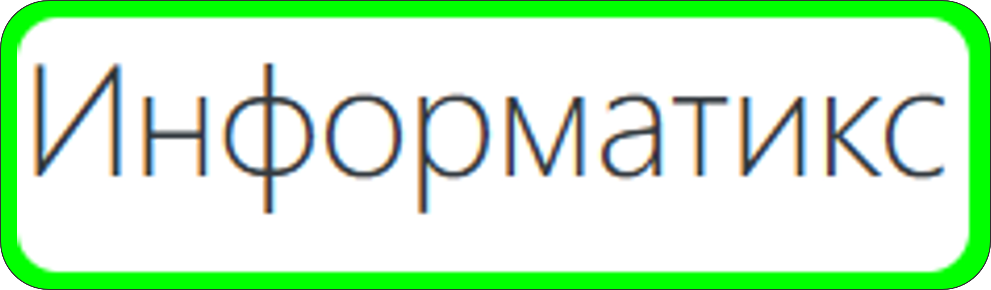
Codeforces
Notes:
There are all provided functionality for creating programming tasks and solve them. Also, codewars are nearest to our product due to high gamification. But our product give much higher flexibility in creating of contests that no other service provide.

Slide 4
Codeforces
Codewars
Notes:
There are all provided functionality for creating programming tasks and solve them. Also, codewars are nearest to our product due to high gamification. But our product give much higher flexibility in creating of contests that no other service provide.

Slide 5
Codewars
The Problem?
Notes:
There are all provided functionality for creating programming tasks and solve them. Also, codewars are nearest to our product due to high gamification. But our product give much higher flexibility in creating of contests that no other service provide.

Slide 6
Codewars
The Problem?
Notes:
On the example of Codeforces, codewars, informatics and other systems that provide ability of creating and solving of programming tasks, we saw dramatic lack of flexibility in creating of such contest.

Slide 7

No Gamification
No Contests
Notes:
On the example of Codeforces, codewars, informatics and other systems that provide ability of creating and solving of programming tasks, we saw dramatic lack of flexibility in creating of such contest.
Identify the Problem: On the example of Codeforces, codewars, informatics and other systems that provide ability of creating and solving of programming tasks, we saw dramatic lack of flexibility in creating of such contest.

Slide 8

No Gamification
No Contests
Notes:
Create a platform for creation of contests with any logic that supports in programming languages. We want provide teachers possibility to make tasks as fun, engaging and gamified as they see fit. Why is our project called CBA? Well, we stated with code battle, which is similar to other names in our area. Then we decided to add Advanced to highlight how revolutionary our website is. Also makes for a better acronym that is easy to remember. Our logo is built from our name with the idea of underscoring of how advanced we are.

Slide 9

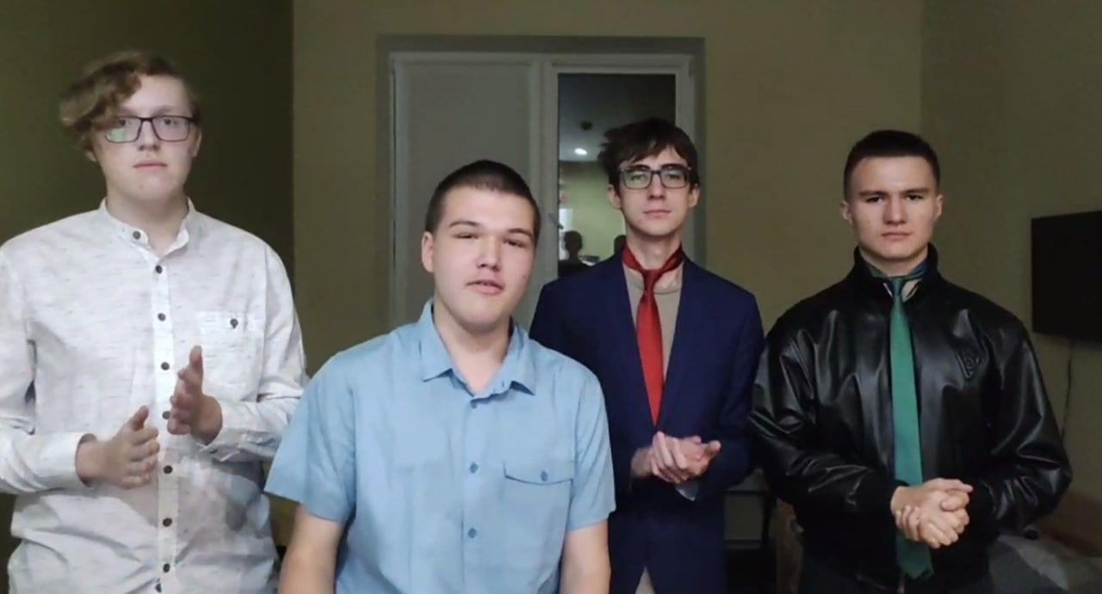

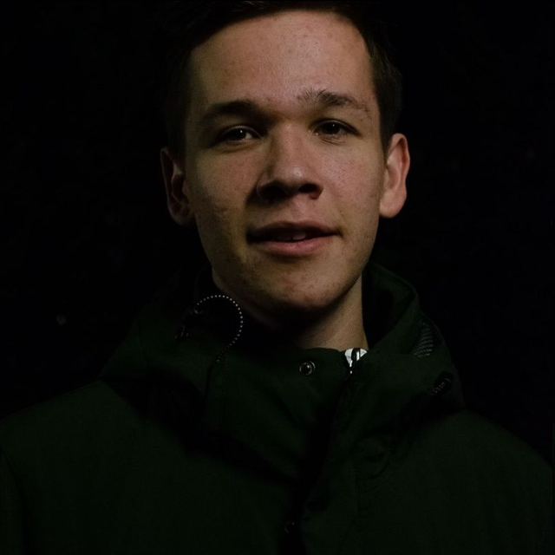
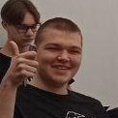
Meet the team
Ivan Sannikov
Fedor Smirnov
Aleksei Morozov
Timur Suleymanov
Ivan Lishchenko
Notes:
Fedor Smirnov
Fullstack
Working on system administration, distributing tasks and cleaning up others’ code
Ivan Lishchenko
Backend
Public relations, development of code responsible for testing tasks
Aleksei Morozov
Frontend
Creating a functional skeleton of the website and integrating it with the database
Timur Suleimanov
Backend
Cleaning up the backend and developing features
Ivan Sannikov
Design
Mocking up the design of the site and implementing it in CSS

Slide 10
Meet the team
Ivan Sannikov
Fedor Smirnov
Aleksei Morozov
Timur Suleymanov
Ivan Lishchenko
Notes:
Fedor Smirnov
Fullstack
Working on system administration, distributing tasks and cleaning up others’ code
Ivan Lishchenko
Backend
Public relations, development of code responsible for testing tasks
Aleksei Morozov
Frontend
Creating a functional skeleton of the website and integrating it with the database
Timur Suleimanov
Backend
Cleaning up the backend and developing features
Ivan Sannikov
Design
Mocking up the design of the site and implementing it in CSS

Slide 11
Meet the team
Ivan Sannikov
Fedor Smirnov
Aleksei Morozov
Timur Suleymanov
Ivan Lishchenko
Notes:
Fedor Smirnov
Fullstack
Working on system administration, distributing tasks and cleaning up others’ code
Ivan Lishchenko
Backend
Public relations, development of code responsible for testing tasks
Aleksei Morozov
Frontend
Creating a functional skeleton of the website and integrating it with the database
Timur Suleimanov
Backend
Cleaning up the backend and developing features
Ivan Sannikov
Design
Mocking up the design of the site and implementing it in CSS

Slide 12
Meet the team
Ivan Sannikov
Fedor Smirnov
Aleksei Morozov
Timur Suleymanov
Ivan Lishchenko
Notes:
Fedor Smirnov
Fullstack
Working on system administration, distributing tasks and cleaning up others’ code
Ivan Lishchenko
Backend
Public relations, development of code responsible for testing tasks
Aleksei Morozov
Frontend
Creating a functional skeleton of the website and integrating it with the database
Timur Suleimanov
Backend
Cleaning up the backend and developing features
Ivan Sannikov
Design
Mocking up the design of the site and implementing it in CSS

Slide 13
Meet the team
Ivan Sannikov
Fedor Smirnov
Aleksei Morozov
Timur Suleymanov
Ivan Lishchenko
Notes:
Fedor Smirnov
Fullstack
Working on system administration, distributing tasks and cleaning up others’ code
Ivan Lishchenko
Backend
Public relations, development of code responsible for testing tasks
Aleksei Morozov
Frontend
Creating a functional skeleton of the website and integrating it with the database
Timur Suleimanov
Backend
Cleaning up the backend and developing features
Ivan Sannikov
Design
Mocking up the design of the site and implementing it in CSS

Slide 14
Meet the team
Ivan Sannikov
Fedor Smirnov
Aleksei Morozov
Timur Suleymanov
Ivan Lishchenko
Notes:
Fedor Smirnov
Fullstack
Working on system administration, distributing tasks and cleaning up others’ code
Ivan Lishchenko
Backend
Public relations, development of code responsible for testing tasks
Aleksei Morozov
Frontend
Creating a functional skeleton of the website and integrating it with the database
Timur Suleimanov
Backend
Cleaning up the backend and developing features
Ivan Sannikov
Design
Mocking up the design of the site and implementing it in CSS

Slide 15
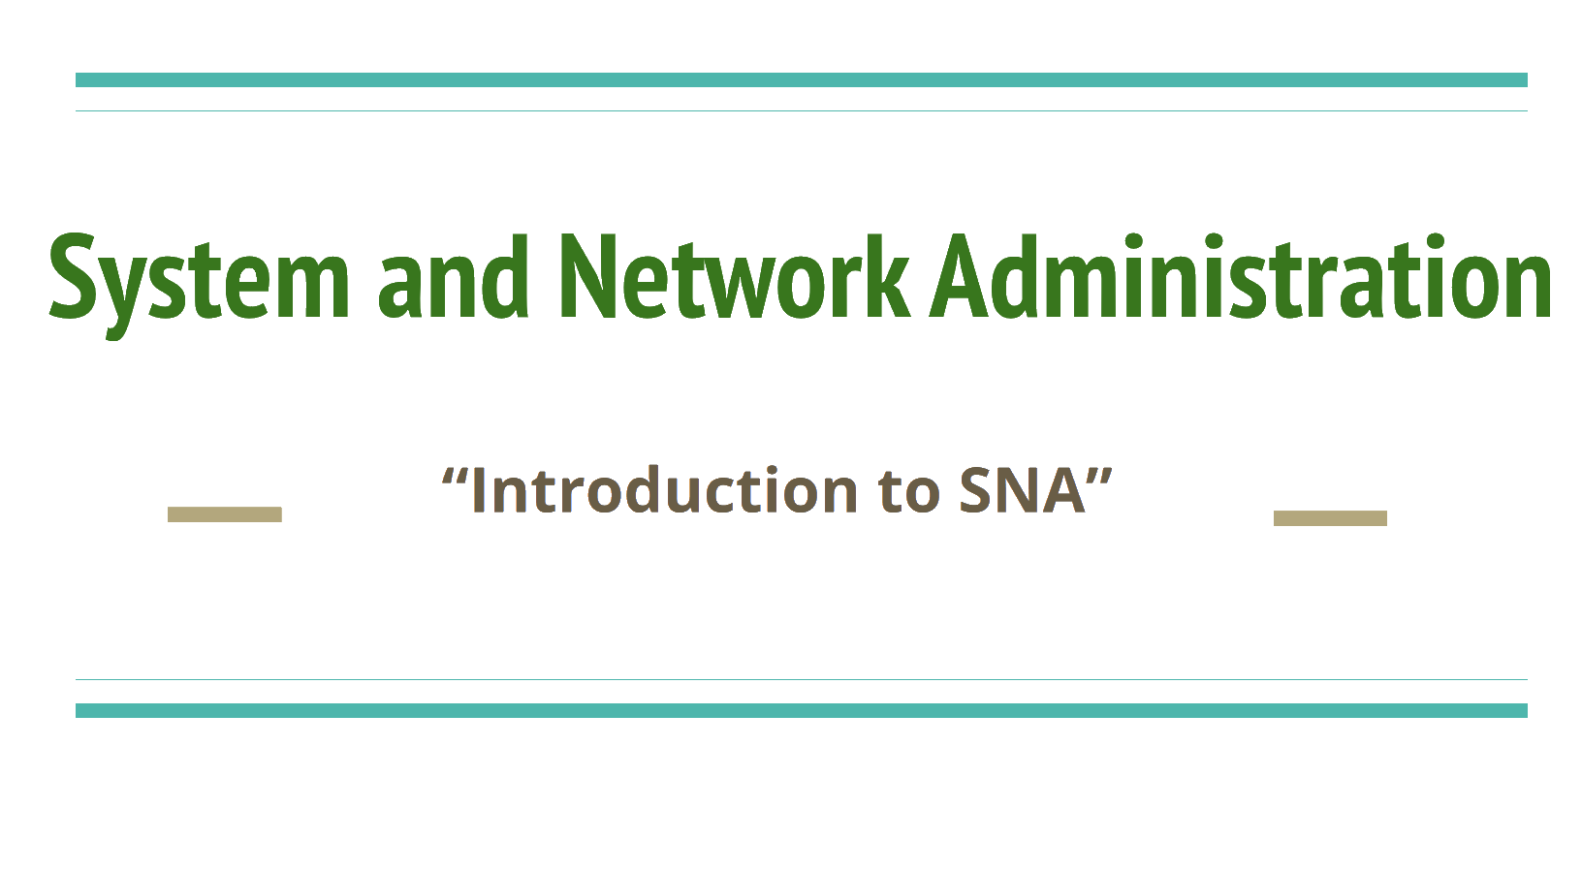
The initial idea
The vision of the project
Notes:
On the example of Codeforces, codewars, informatics and other systems that provide ability of creating and solving of programming tasks, we saw dramatic lack of flexibility in creating of such contest.

Slide 16
Our Target Audience
Contest creators
Contest participants
Notes:
On the example of Codeforces, codewars, informatics and other systems that provide ability of creating and solving of programming tasks, we saw dramatic lack of flexibility in creating of such contest.

Slide 17
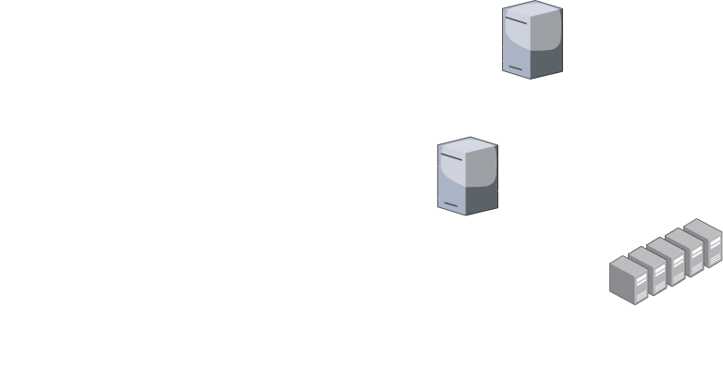

Slide 18
Workload
Website Development
Contest Management
Task Judging
System Administration

Slide 19



Workload
Website Development
Contest Management
Task Judging
System Administration
Website

Slide 20



Workload
Website Development
Contest Management
Task Judging
System Administration
Code and Container Coordination
Website

Slide 21

Workload
Website Development
Contest Management
Task Judging
System Administration
Code and Container Coordination
Website
Contest Management

Slide 22
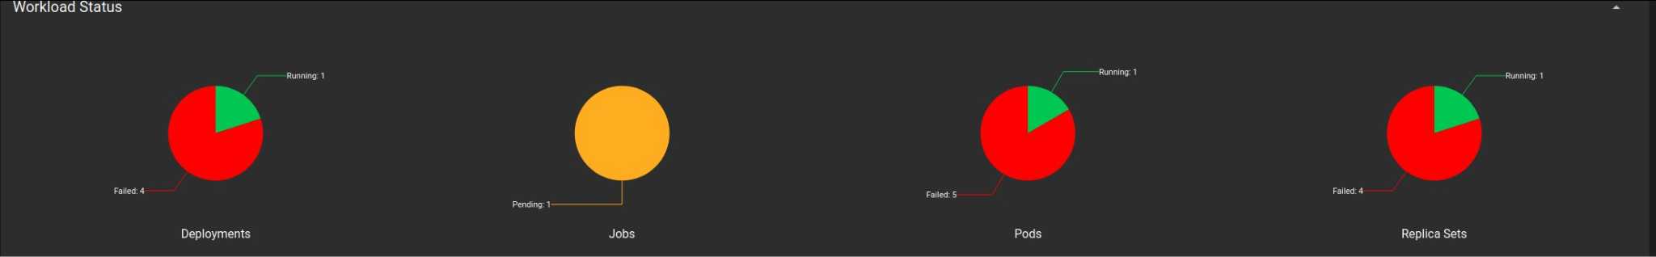
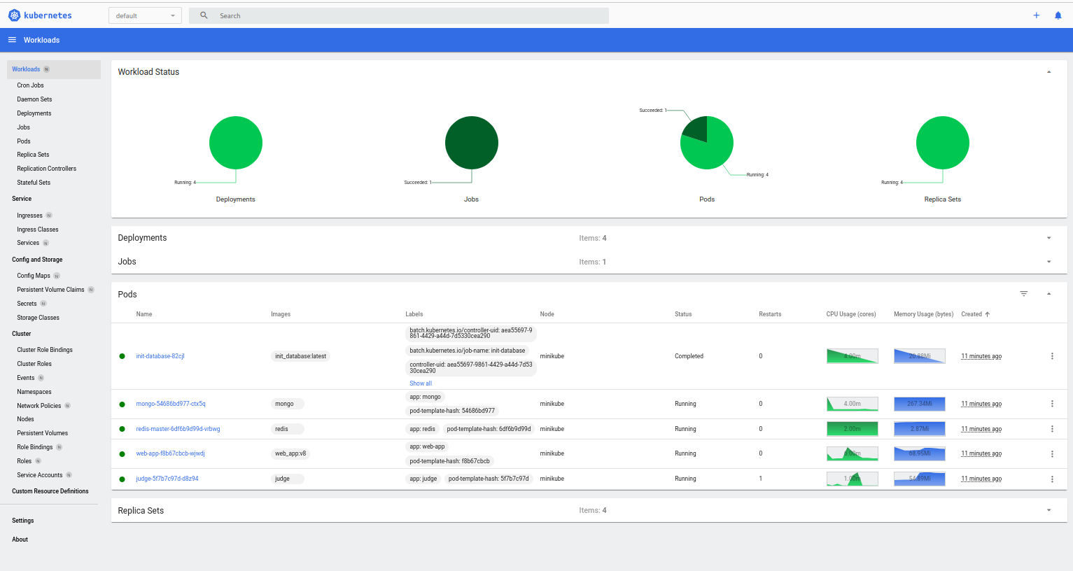
HISTORY

Slide 23
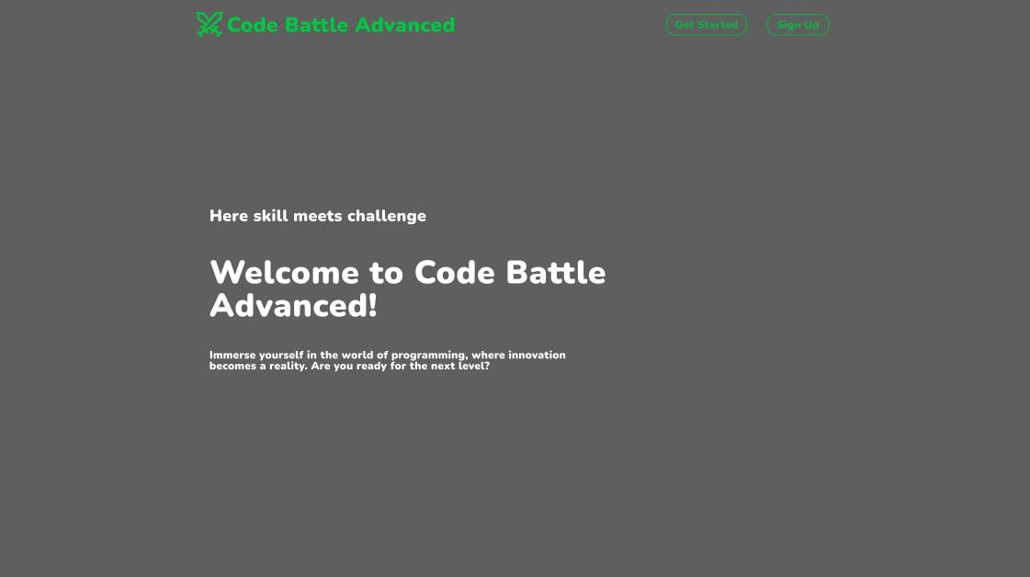
HISTORY

Slide 24
HISTORY

Slide 25
Milestones
Personal pages
All operational
Group support
Create 10 different Contests
Team support
Add more customizations
Invite expert for frontend
University partnership
Rewrite the frontend
Launch

Slide 26
Milestones
Personal pages
All operational
Group support
Create 10 different Contests
Team support
Add more customizations
Invite expert for frontend
University partnership
Rewrite the frontend
Launch

Slide 27
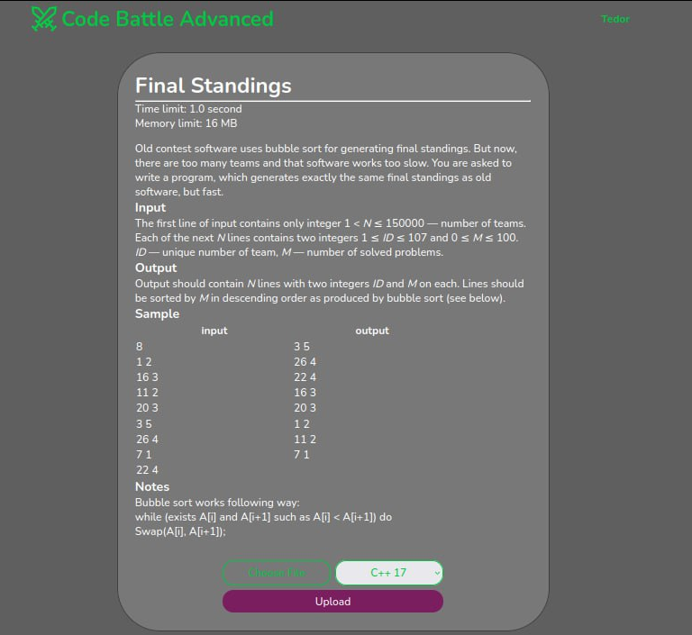

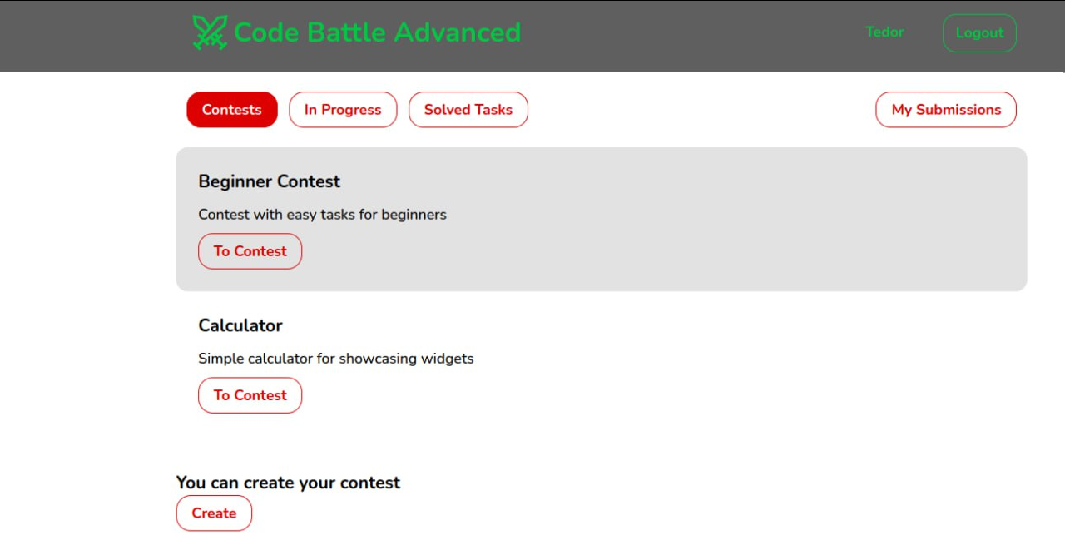
The MVP showcase

Slide 28
Thank you for listening!

Slide 29
Any questions?

